Slide 1


Team Titans
Open Innovation- Climate Change
Eco-Defenders
Sunaina G P
Varsha Ravindra Shetty

Slide 2

Problem Statement
Climate change poses one of the most pressing challenges to humanity, impacting ecosystems, economies, and livelihoods worldwide. Addressing climate change requires collaborative and innovative solutions that encompass a wide range of disciplines, technologies, and perspectives.

Slide 3



Contents
Future Scope
Overview
Technical Overview
Market Prospect

Slide 4

OVERVIEW
A decentralized platform dedicated to tackle pressing climate issues.
Identifying key challenges in climate action includes lack of centralized funding challenge, limited resources, and the absence of a dedicated platform.
Usually, experts and stakeholders struggle to connect on a sustainable solution due to the absence of a platform.
Allows industry experts or environmentalists to create campaigns regarding climate issues. Where smart contracts are used for secure and transparent funding. Our solution leverages blockchain to ensure that contribution directly supports impactful projects.

Slide 5
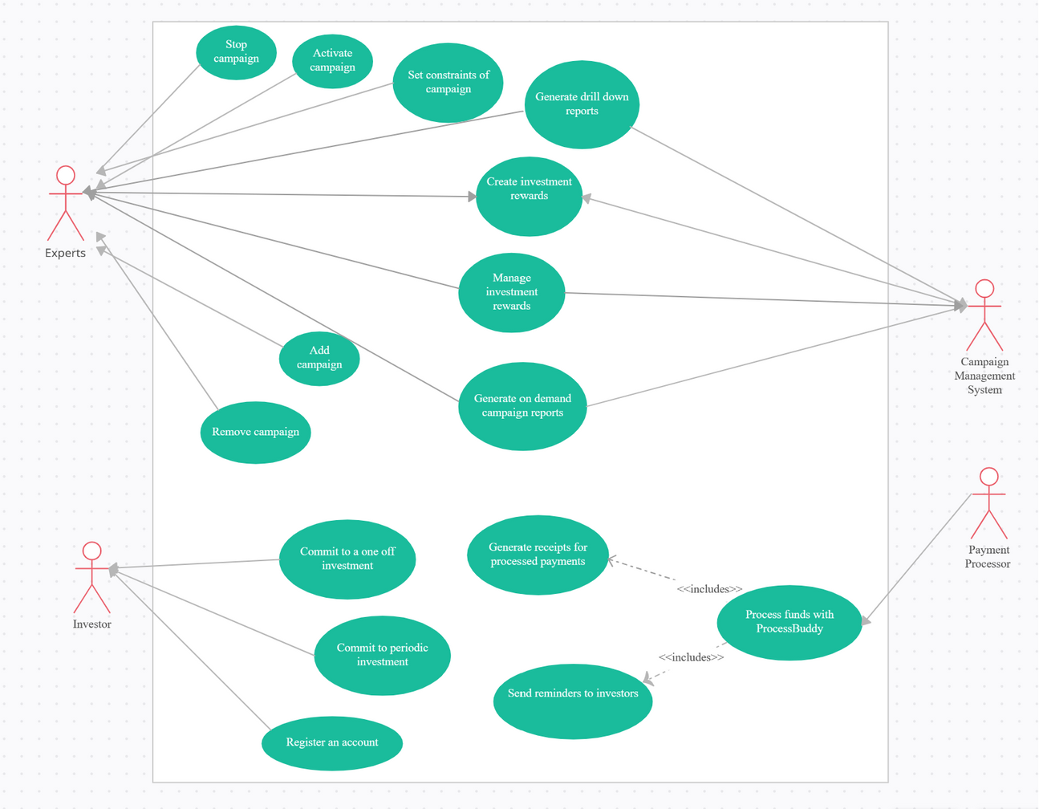
Technical Overview / UML Diagram
Our platform employs user registration, secure authentication, and payment processing integration to facilitate project creation and backer contributions. Project Creators detail campaigns with funding goals, multimedia content, and timelines, while backers browse and select projects. The platform handles diverse currencies, ensures transaction security, and offers refund procedures if goals aren't met. Advanced features include search, filtering, and recommendation systems to aid project discovery. The system's success relies on robust security, effective payment handling, and user-friendly project management tools.

Slide 6

TECH STACK USED
Front-End Development:- HTML, CSS, REACTJs, Tailwind (css)
Back-End Development:- NodeJS, Javascript, Solidity(Smart-Contratcs)
Payment-Processing Gateway:- Ethereum, MetaMask.

Slide 7
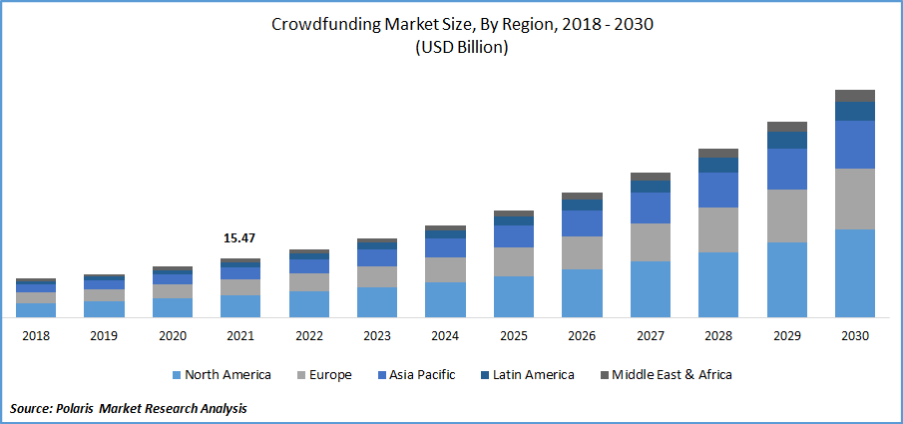

Market Prospect
Global Reach: The platform can reach at a global level as climate issue is not something which is specific to a certain region, and contributors around the globe can participate and support the campaign.
Regulatory Support: As climate action gains importance worldwide, governments and regulatory bodies may introduce supportive policies and regulations for platforms and initiatives dedicated to addressing environmental challenges.
Collaboration Opportunities: Climate experts, activists, organizations, and businesses are constantly seeking opportunities to collaborate on climate solutions. Your platform provides a space for these stakeholders to connect and work together on impactful projects.
Rising Climate Concerns: The urgent need to address climate change has gained significant attention in recent years. Governments, businesses, and individuals are increasingly committed to taking action. A platform focused on climate crowdfunding aligns with this global trend.

Slide 8

Future Scope
Footstep-to-Crypto Conversion for Climate Donations: Using footstep counts of the user and rewarding them with Ethereum that can be used for donating.
Partnerships: Collaborate with fitness app developers, environmental organizations, and health and wellness companies to expand the reach of the footstep-to-crypto conversion feature.
Incentives and Rewards: Consider offering incentives and rewards for users who consistently contribute to climate action through their footsteps. This could include access to exclusive campaigns, NFTs, or recognition within the platform's community.
Sustainable Marketplace: Create an e-commerce section within the platform where users can purchase eco-friendly products and services from verified green vendors. A percentage of the proceeds can be directed toward funding climate initiatives.

Slide 9
Team Titans
Thank You
Sandra Haro

